Slide 1
Artificial Intelligence Experimentation Facility For the Energy sector
Presentation – WP 3.1

Slide 2
Project Context
WP 3.1 Responsibilities :
  Energy Data Generation (Generates raw energy consumption data)
  Energy Data Analysis (Analyses it for patterns and efficiency)
  Report Generation (Creates easy to read reports)
WP 3.2 Responsibilities :
  Orchestration across services
Client Requirements
  Transition from batch containers -> long-running gRPC services.
  Structured, production-ready architecture
All of this will run on the AI4EU platform, so others can use it easily.

Slide 3
Phase 1
- Three separate python-based containers were created :
  Data Generator
  Data Analyzer
  Report Generator
- They were run once and exit containers, batch style execution was happening.
- They were hard to connect together and run continuously.
DATA GENERATOR
DATA ANALYZER
REPORT GENERATOR

Slide 4
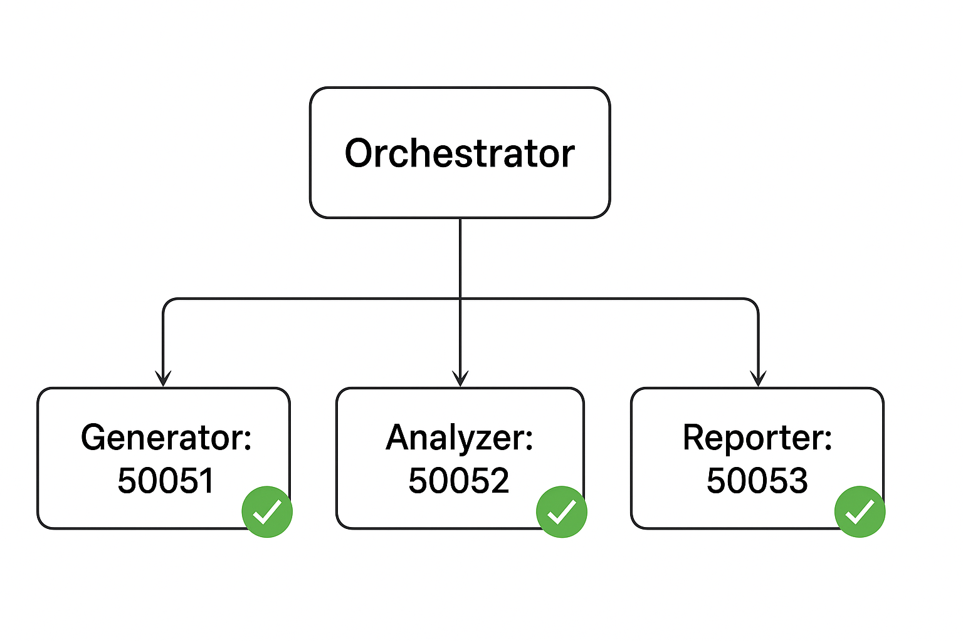
Phase 2
Converted all three containers into gRPC microservices.
Each service runs continuously on fixed ports :
  Generator -> 50051
  Analyzer -> 50052
  Reporter -> 50053
Standardized structured responses (success, message, code, output_path)
Implemented SIGTERM graceful shutdown
Added gRPC health checks

Slide 5
Service Architecture
- Generator makes raw energy data.
- Analyzer processes it into useful insights.
- Reporter creates the final human-friendly report.
Orchestrator (WP3.2) coordinates the steps.
Key Features:
Health monitoring
JSON structured logging
Clear error codes (INVALID_ARGUMENT, NOT_FOUND, INTERNAL, etc.)
Docker-compose with service health dependencies

Slide 6
Testing
Unit tests for core logic
Service tests: RPC calls with valid/invalid inputs (Added structured logs (machine-readable, for monitoring))
Integration tests with orchestrator workflow (Added tests to make sure each service works alone and together)
Failure injection: missing files, corrupted inputs, resource errors (Added error codes so we know what went wrong (e.g., “file not found” vs. “internal error”))
Docker-compose setup ensures they start in the right order

Slide 7
Onboarding to AI4EU
Packaged everything into a solution.zip
AI4EU’s AI-Builder tool imported it
The package contains:
Microservices (our three containers)
Deployment scripts
Orchestration info (dockerinfo.json)
On AI4EU:
Users can run the full pipeline end-to-end

Slide 8
Targets Achieved
Converted batch containers into continuous gRPC services.
Defined & implemented service architecture.
Added error model, health checks, graceful shutdown.
Fully tested before handover to WP3.2.
Successfully onboarded to AI4EU using AI-builder (ready for orchestration & scaling).
Solution .zip file obtained.

Slide 9
Next Steps
WP3.2 orchestrator integration using our gRPC endpoints
Add monitoring dashboards
Add persistence storage and resource management (Kubernetes)
Security hardening (authentication, encryption and more)
(All deliverables completed & successfully deployed to AI4EU)

